Slide 1
Smart watch and Biopac: using GSR data for distinguishing cognitive states
Guido Zuidhof
December 2014

Slide 2
Cognitive load measurement
Many approaches to measuring cognitive load
R. Brünken et al. (2003), Direct Measurement of Cognitive Load in Multimedia Learning. Educational Psychologist 38(1), 53-61
 | Indirect | Direct
Subjective | Self-reported invested mental effort | Self-reported stress level Self-reported difficulty of materials
Objective | Physiological measures Behavioral measures Learning outcome measures | Dual-task performance Brain activity measures (e.g. fMRI) (arguably also indirect)

Slide 3
Cognitive load measurement
Many approaches to measuring cognitive load
 | Indirect | Direct
Subjective | Self-reported invested mental effort | Self-reported stress level Self-reported difficulty of materials
Objective | Physiological measures Behavioral measures Learning outcome measures | Dual-task performance Brain activity measures (e.g. fMRI) (arguably also indirect)

Slide 4
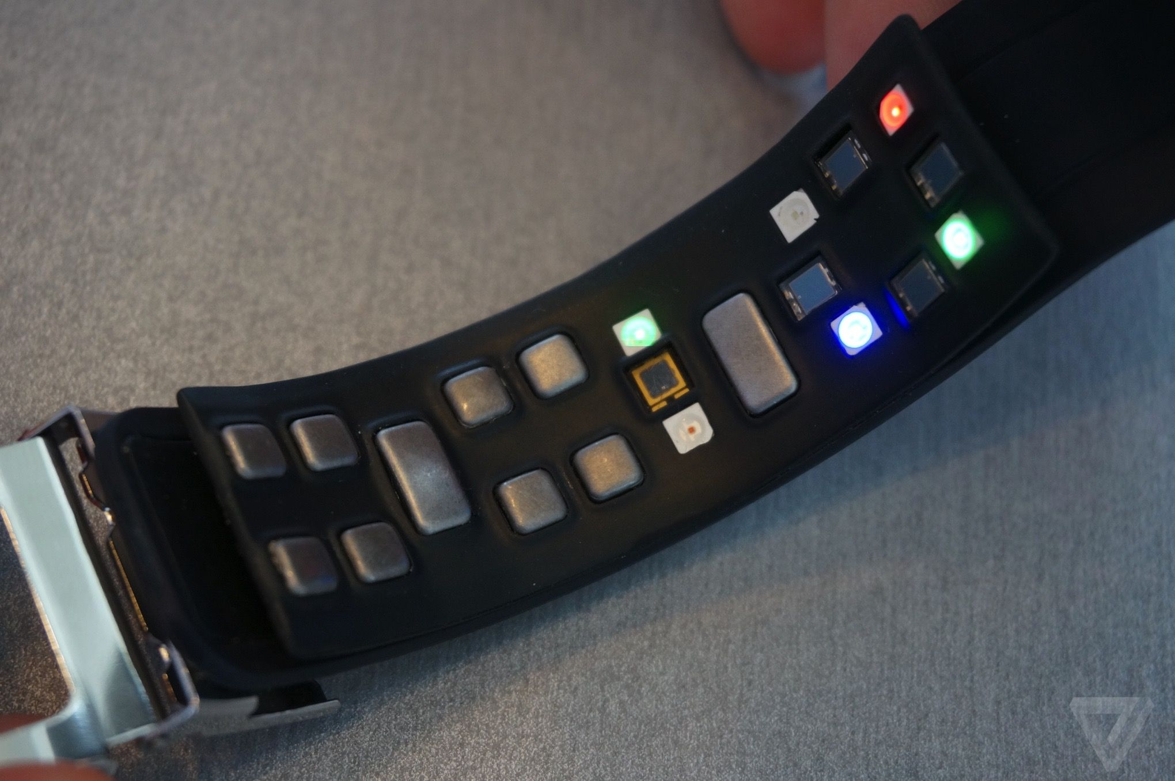
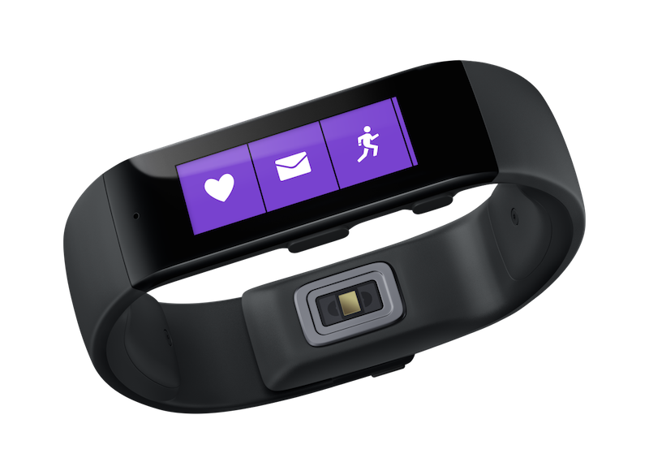
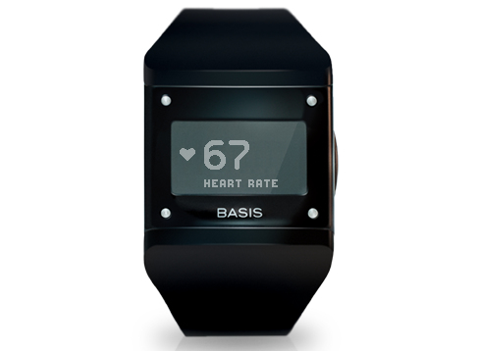
New smartwatches feature biometric sensors (measuring physiological signals)
APIs are generally lacking, data is locked in proprietary apps
Samsung Simband
Microsoft Band
BASIS Watch

Slide 5
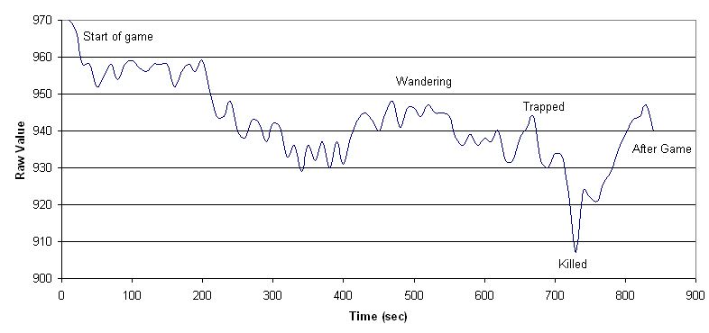
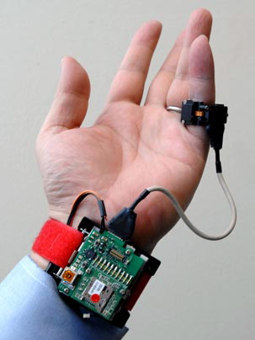
Physiological response
The body responds when cognitive load is increased/reduced
Many different options for measuring, like:
Blood oxygen level
Skin temperature / heat flux
Blood pressure
Motion (accelerometer)
Heart rate variability
Respiratory rate
Galvanic Skin Response
Facial expressions
Pupil dilation
Measuring these is often not mutually exclusive
Notes:
Multiple can be measured simultaneously

Slide 6
Physiological response
The body responds when cognitive load is increased/reduced
Many different options for measuring, like:
Blood oxygen level
Skin temperature / heat flux
Blood pressure
Motion (accelerometer)
Heart rate variability
Respiratory rate
Galvanic Skin Response (GSR)
Facial expressions
Pupil dilation

Slide 7
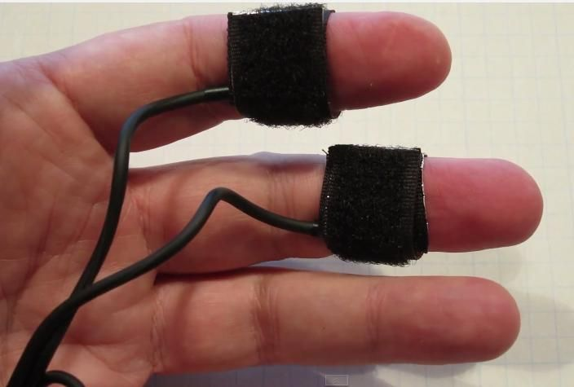
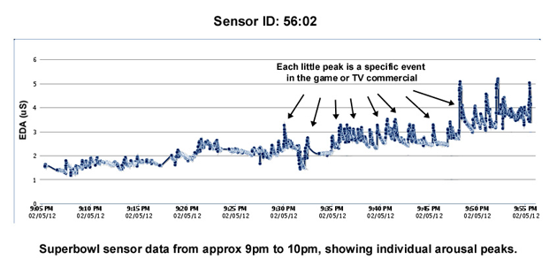
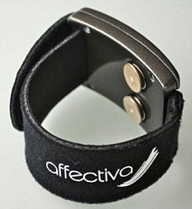
Galvanic Skin Response (GSR)
Measuring the electrical skin conductance
Small voltage applied to electrodes, flowing current measured
Unit of measurement: μS (microsiemens)
Influenced by sweat glands
Delay between stimulus and response between 0.8 and 4 seconds
Notes:
GSR is measuring the electrical skin conductance,
Unit of measurement is micro siemens
More sweat -> higher conductance, sweating caused by primitive ‘fight or flight’ response, preparing for exertion to deal with threat
Delayed response

Slide 8
Why measure cognitive load?
“You should take a break”
Automatic difficulty adjustment in applications (such as games)
People on the autism spectrum do display physiological response
Classroom applications, are students following/getting it?

Slide 9
Goal
Determining cognitive load from GSR data
Method
Measure GSR data using tasks with varying difficulty
Classify task difficulty from features of the GSR data

Slide 10
Experiment
Arithmetic tasks with varying difficulty
Addition of four numbers, presented one by one
4 difficulty levels
8 tasks per subject, in random order
Difficulty | Example Task
1 | 0 + 1 + 1 + 1
2 | 3 + 5 + 7 + 2
3 | 31 + 40 + 67 + 24
4 | 163 + 721 + 573 + 594

Slide 11
***

Slide 12
48

Slide 13
71

Slide 14
50

Slide 15
34

Slide 16
203
196
199

Slide 17
**

Slide 18
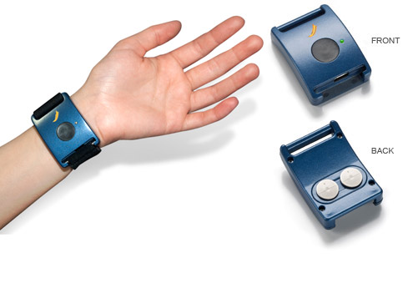
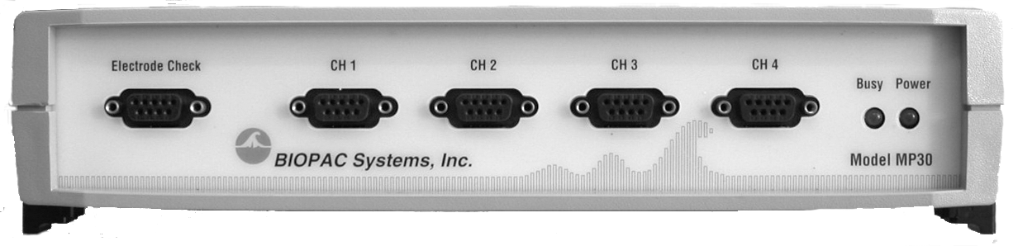
Apparatus
Affectiva Q Sensor (dry electrodes on wrist)
BIOPAC MP30
(wet finger electrodes)

Slide 19
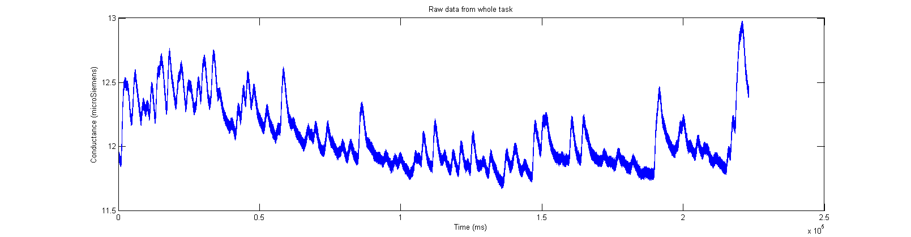
Raw data

Slide 20
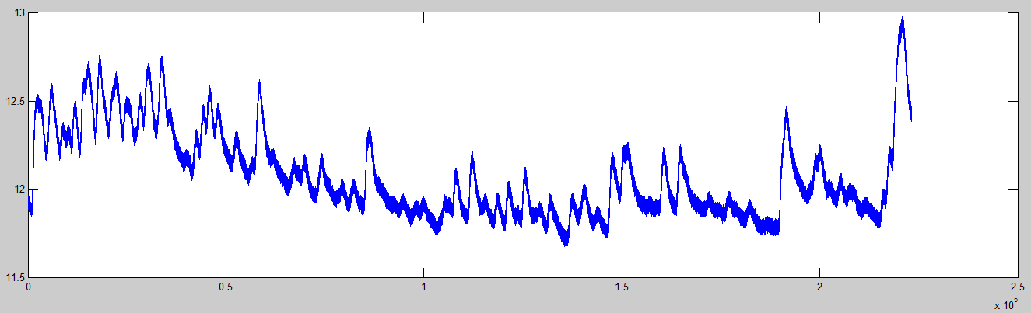
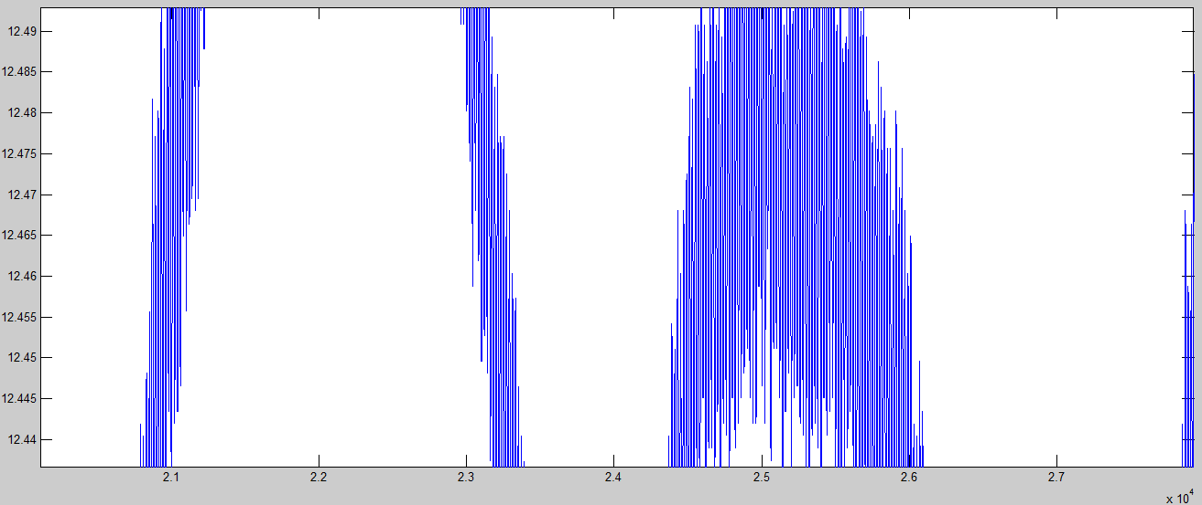
Raw data
DC current noise (50Hz) in signal

Slide 21
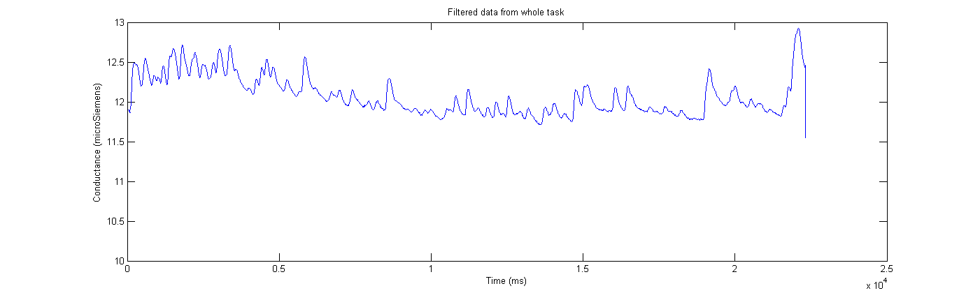
Preprocessing
Smoothing filter (removing DC current)
(Savitzky-Golay filtering)
Notes:
Low Pass Filter didn´t cut it

Slide 22
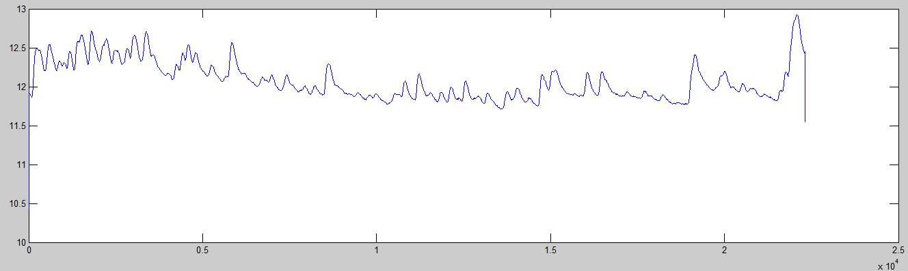
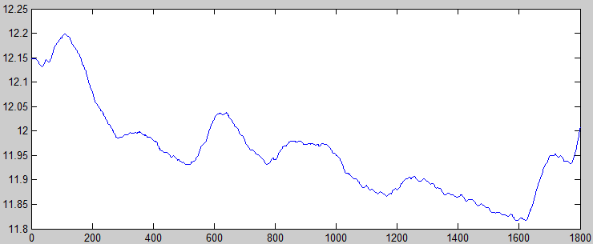
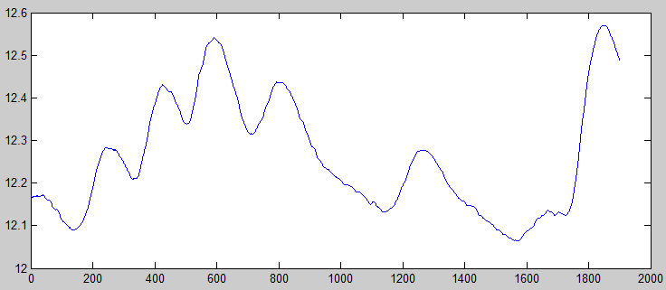
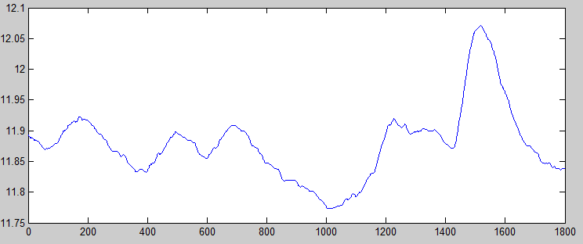
Preprocessing
Cutting the tasks out of the data
...

Slide 23
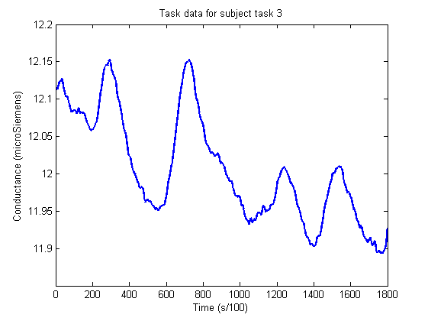
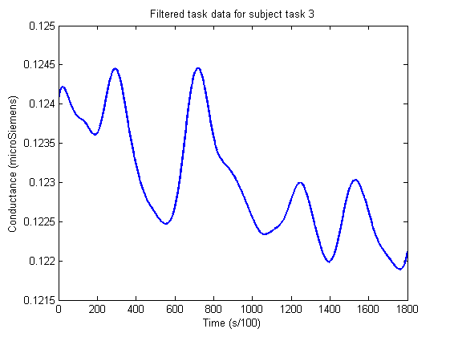
Final preprocessing
Normalizing (dividing by subject average GSR over all tasks)
Smoothing out small DC current spikes (Savitzky-Golay filtering)

Slide 24
Transformation
Extract time domain features
Export to an easily parsable format (CSV)
'luc' 'diff2' [221.4503] [0.1230] [7.3118e-04] [0.0020] [6] [6] [5] [4]
luc,diff2,221.4503,0.12303,0.00073118,0.0019555,6,6,5,4
(Subject, Difficulty, Accumulative, Average, Standard Deviation, Peak count with varying tresholds)

Slide 25
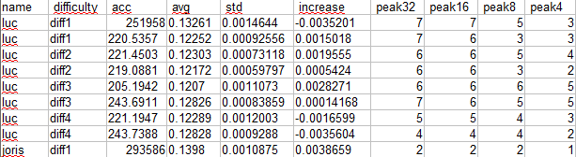

Building a classifier
CSV data fed to Weka Data Mining Software
Easy to try multiple classifier training algorithms
Also great for visualization

Slide 26
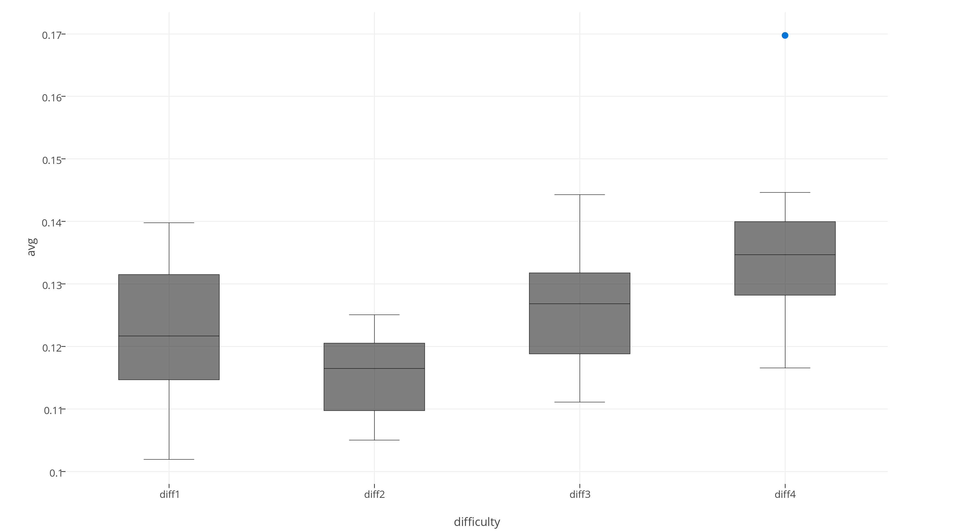
Visualization
Average GSR

Slide 27
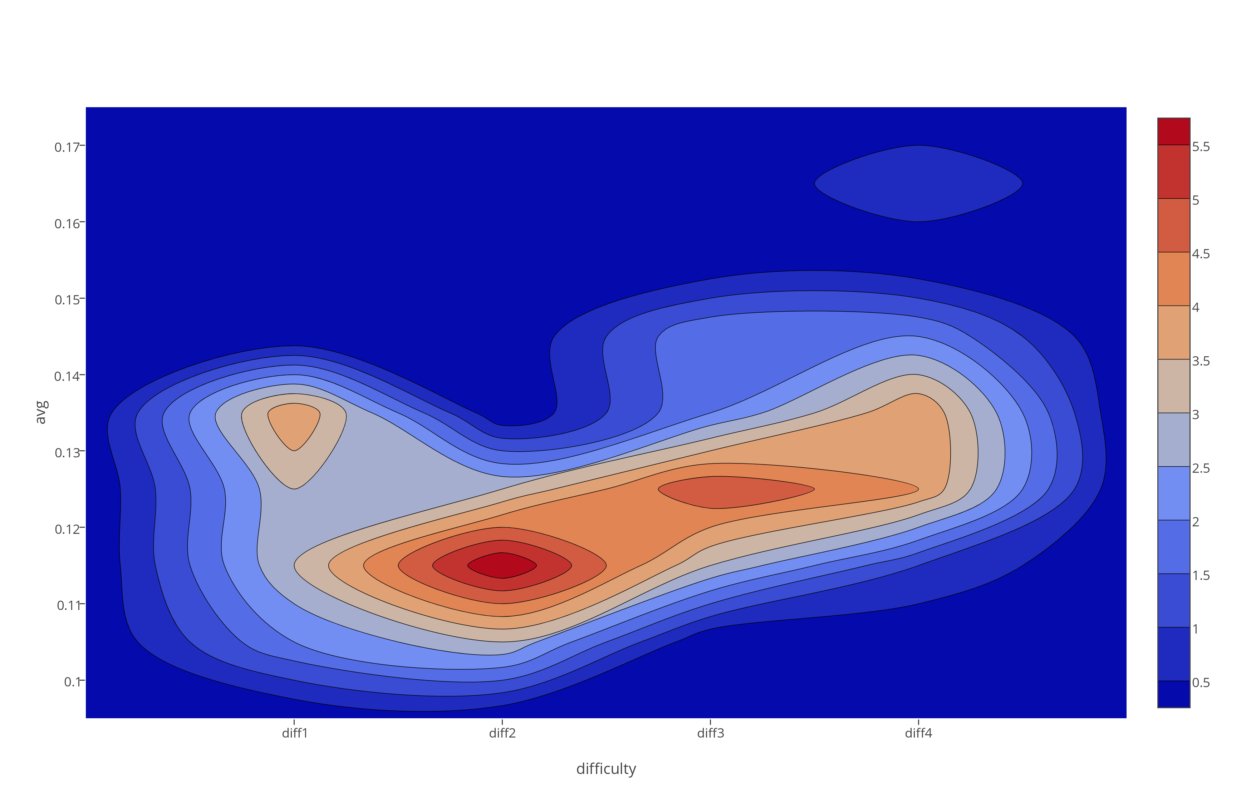
Visualization
Average GSR

Slide 28
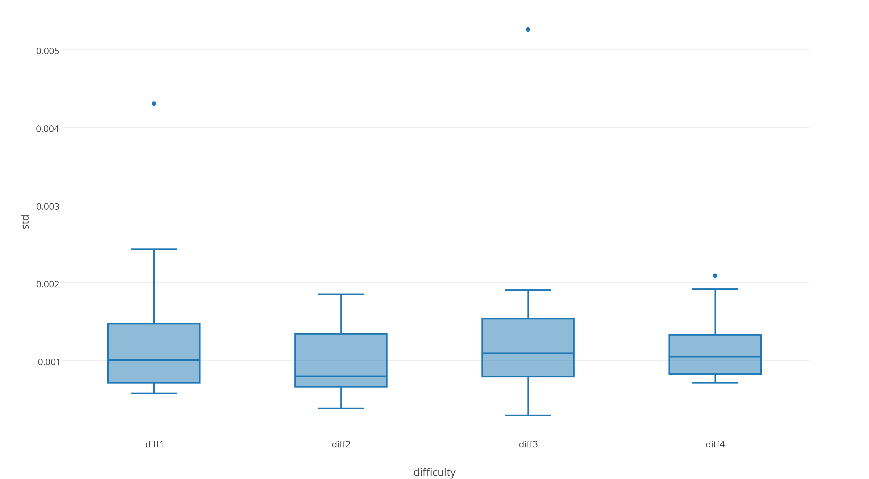
Visualization
Standard Deviation

Slide 29
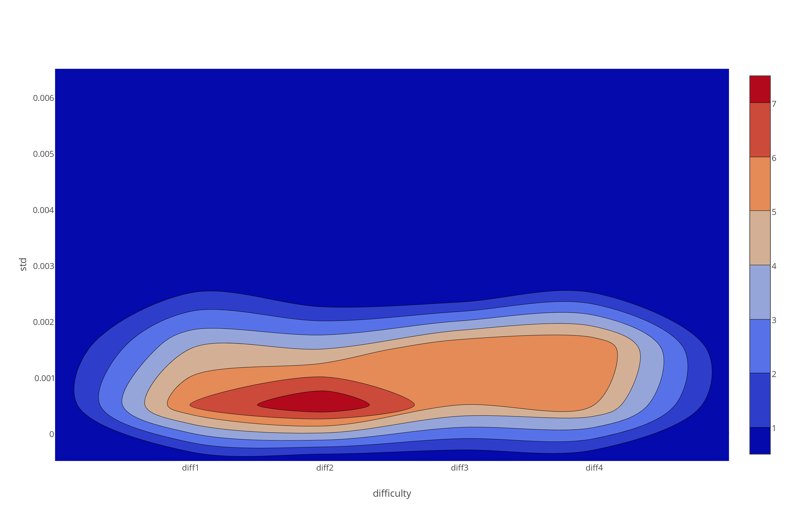
Visualization
Standard Deviation

Slide 30
Preliminary results
10 Folds cross-validation was used
Classifier | Correctly Classified Instances %
SimpleCart (Minimal Cost Decision Tree) | 33.33%
J48Graft (Decision tree) | 43.75%
BayesNet (Bayesian probability estimation) | 25%
Naïve Bayes | 33.33%
LWL (Locally weighted learning) | 41.67%
Multilayer Perceptron (20 hidden layers) | 29.17%
SMO (Support Vector Machine class algorithm) | 6.25%
JRIP (Rule based learner) | 18.75%
Simple classifiers seem to work best. Expected from small dataset size.
Notes:
Note that 25% is expected from chance
Not great.

Slide 31
Preliminary results
10 Folds cross-validation was used
Classifier | Correct % 4 classes | Correct % 2 classes
SimpleCart (Minimal Cost Decision Tree) | 33.33% | 72.92%
J48Graft (Decision tree) | 43.75% | 77.08%
BayesNet (Bayesian probability estimation) | 25% | 75%
Naïve Bayes | 33.33% | 60.42%
LWL (Locally weighted learning) | 41.67% | 75%
Multilayer Perceptron (20 hidden layers) | 29.17% | 62.50%
SMO (Support Vector Machine class algorithm) | 6.25% | 58.33%
JRIP (Rule based learner) | 18.75% | 79.12%
Notes:
Classifying between task 1,2 and task 3,4 combined
50% expected from chance.
Still not great / good enough

Slide 32
Improving the classification
Classification accuracy is not great however, possible reasons
Small dataset (6 participants * 8 tasks = 48 entries)
Experiment
Design susceptible to ´task bleeding´, i.e. sweat from last task carries over
Sensor inaccuracy
Not the right features extracted from data
It is simply not classifiable better from GSR data

Slide 33
Summary
Using biometrics to determine cognitive load outside of the lab is exciting
I measured GSR during tasks of varying difficulty
Classifying task difficulty from this data is the goal
Next up is seeing whether I can improve this classification by extracting different features

